Slide 1
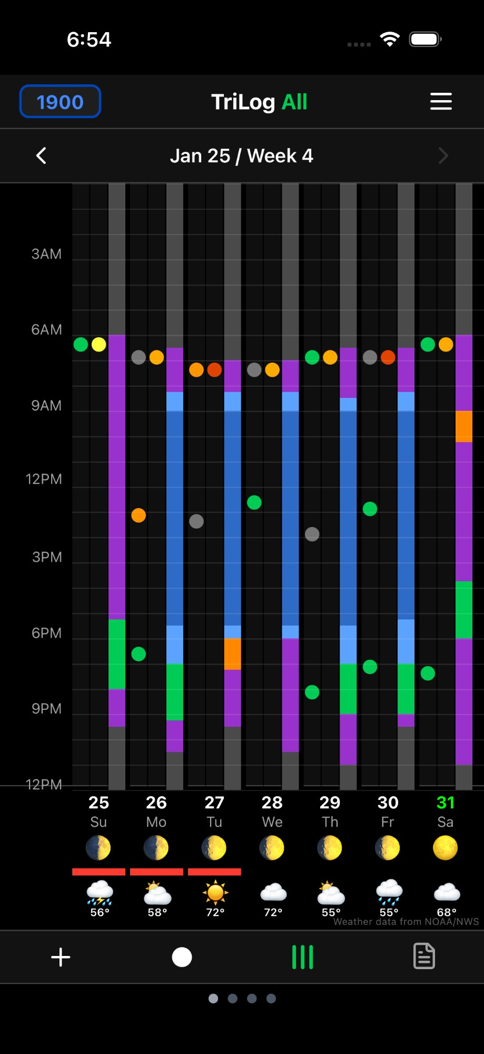
TriLog
See Your Life at a Glance
Track mood, energy, and activities in a beautiful visual timeline.
Spot patterns. Build habits. Know yourself better.
Mood
Energy
Available on iOS • Free with optional Pro

Slide 2
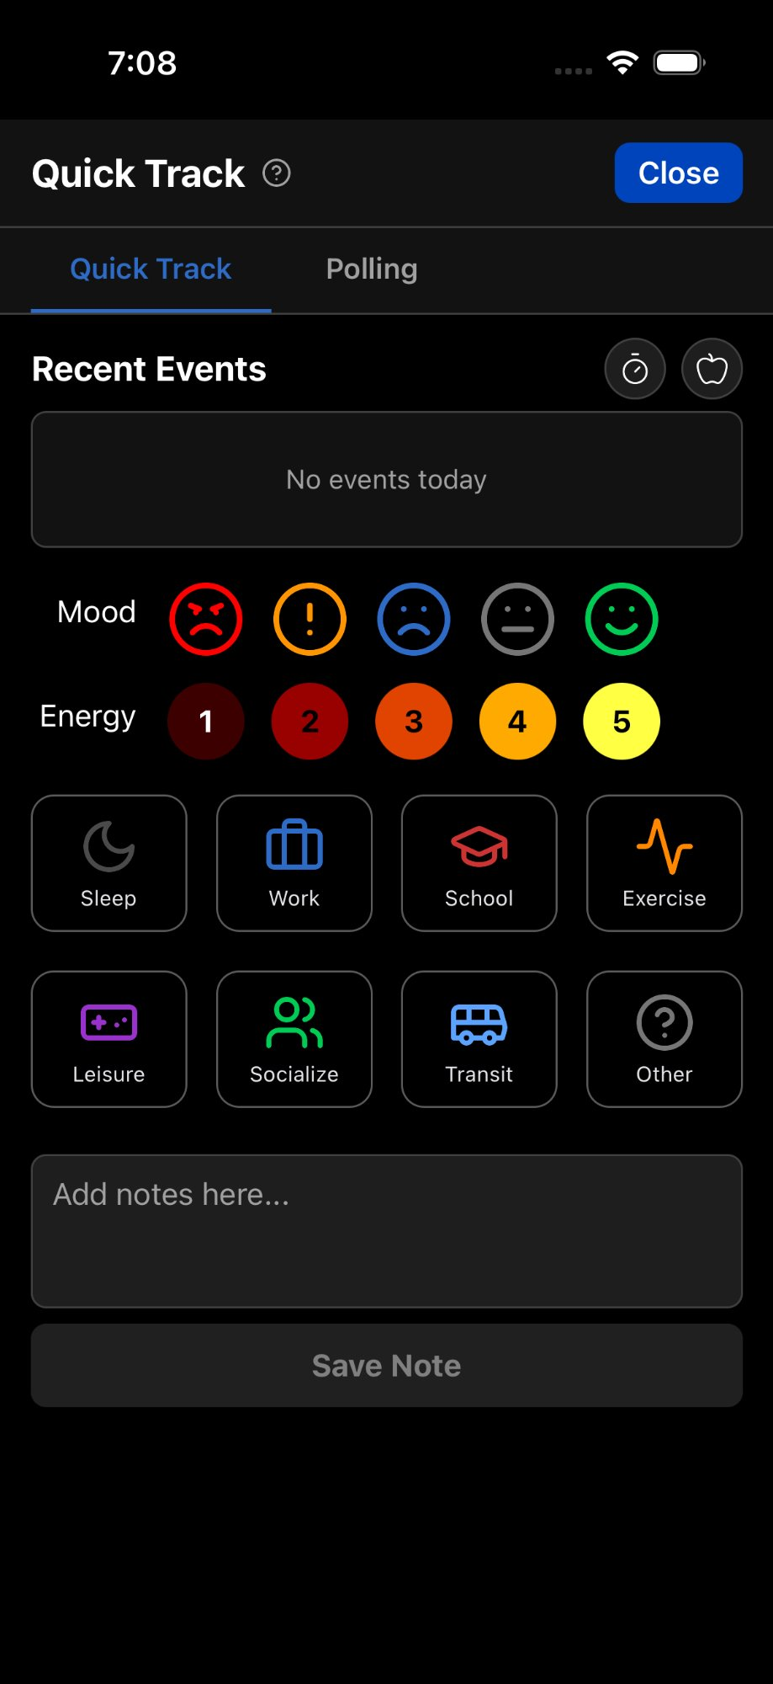

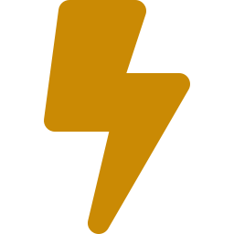
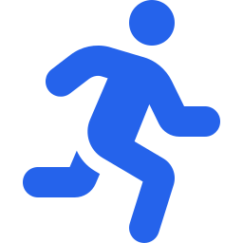
What is TriLog?
A visual life tracker that turns your daily mood, energy, and activities into patterns you can see and learn from.
Mood
Energy
Activity
5 emotional states from Happy to Upset. Quick tap, don't overthink it.
5 vitality levels from exhausted to fully charged. Separate from mood.
What you're doing: Sleep, Work, Exercise, Leisure, Socialize, and more.
Quick entry in seconds

Slide 3
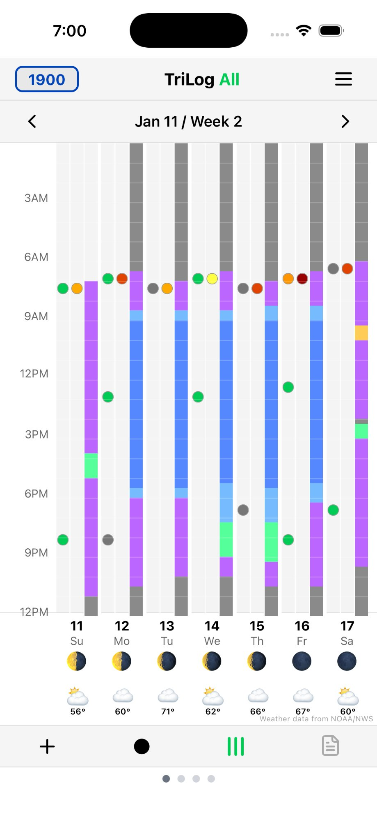
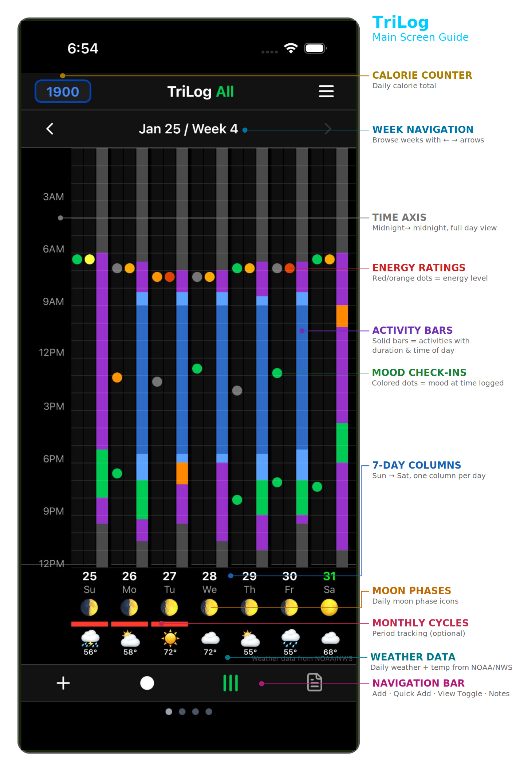
The Visual Grid
Your entire week on one screen — 7 days × 24 hours = 168 hours at a glance
Columns = Days
Sunday through Saturday, current day highlighted
Rows = Hours
Midnight to midnight, 24-hour vertical axis
Colored Blocks
Activities shown as colored bars: blue=sleep, red=work, green=exercise, purple=leisure
Mood & Energy Dots
Small colored indicators at activity boundaries
Weather Strip
Daily weather icons with temperature at bottom
Moon Phases
Light theme
Lunar cycle indicators for sleep pattern correlation

Slide 4
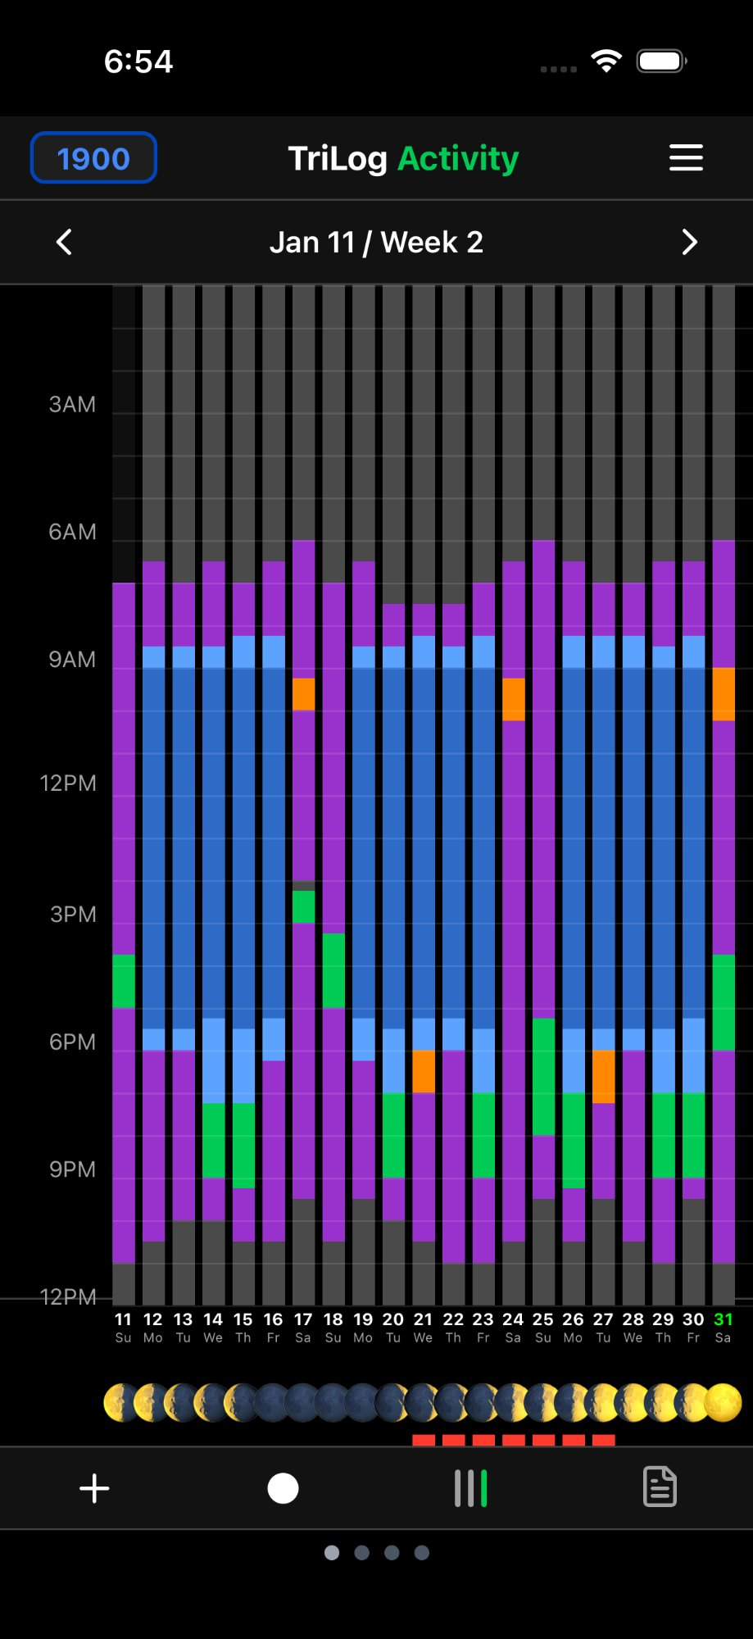
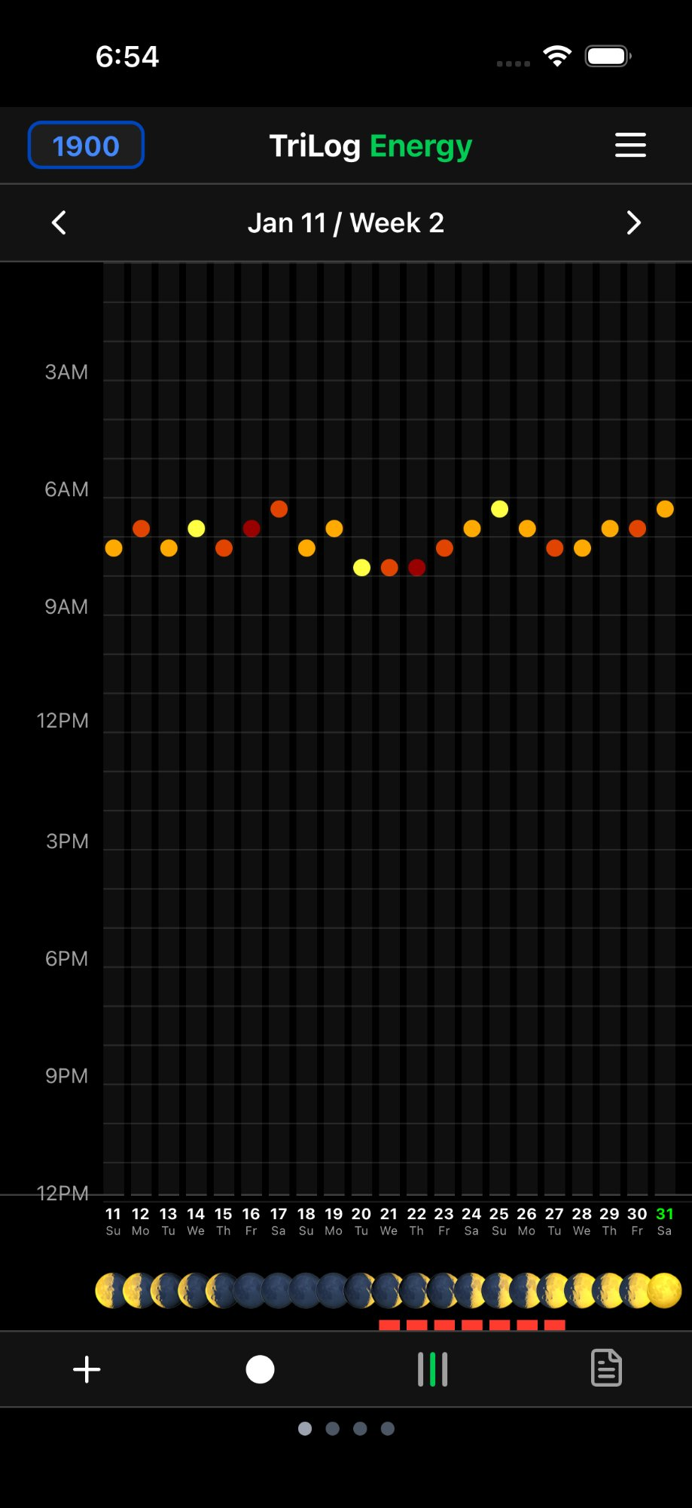
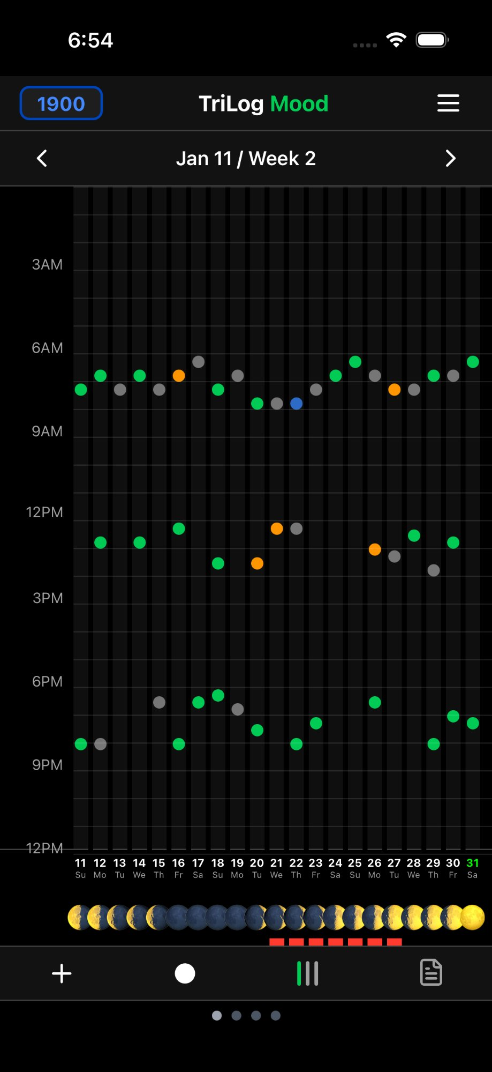
Focus on What Matters
Switch between all metrics or isolate mood, energy, or activity across 3 weeks
All Metrics
Activity Only
Energy Only
Mood Only

Slide 5
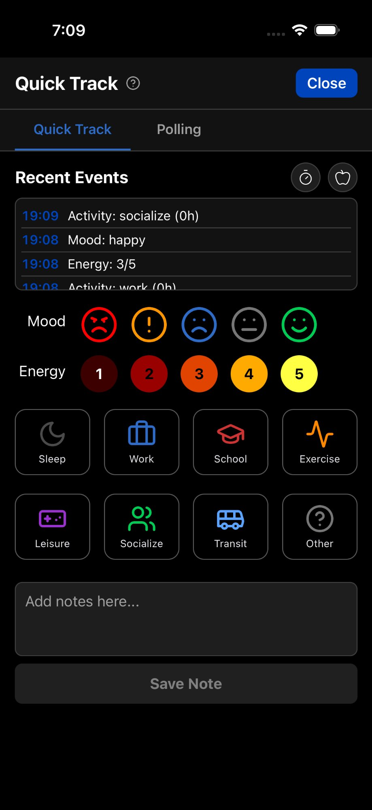
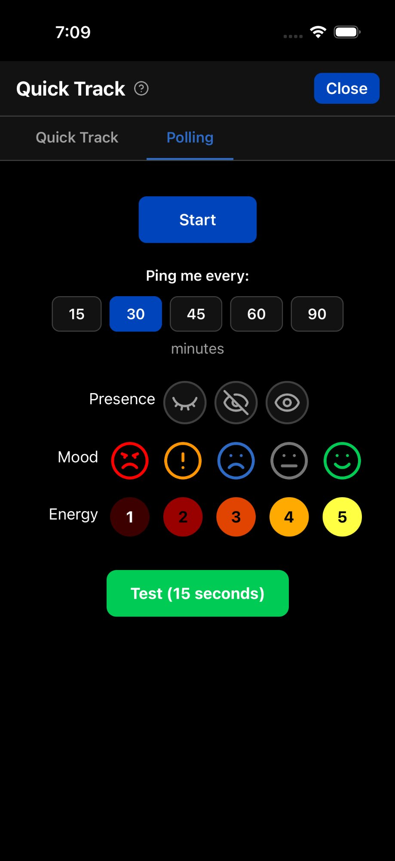


Effortless Tracking
Quick Track
Log mood, energy, and activity in seconds. Tap icons — no modals, no friction. See recent events in a timeline. Perfect for busy days.
Polling Notifications
Gentle reminders every 15–90 minutes ask how you're doing. Respond in one tap via Quick Track. More data points, richer patterns.
Quick Track
Polling

Slide 6
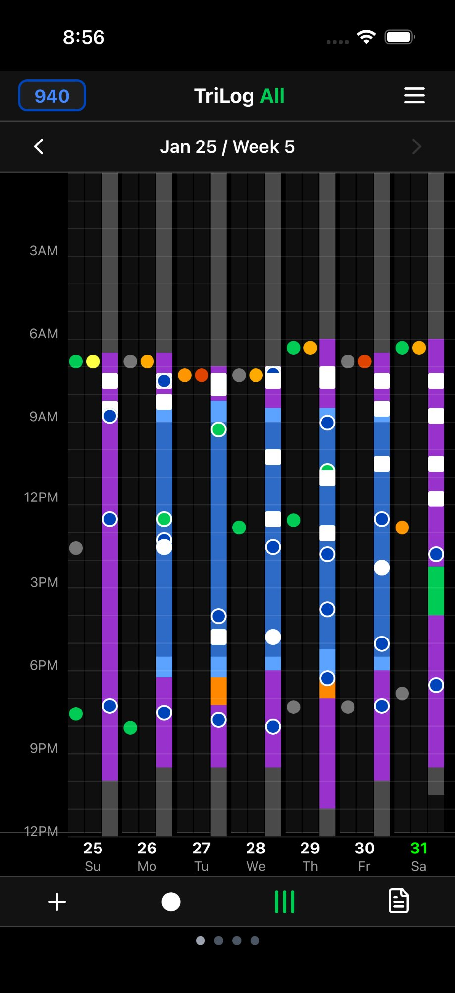
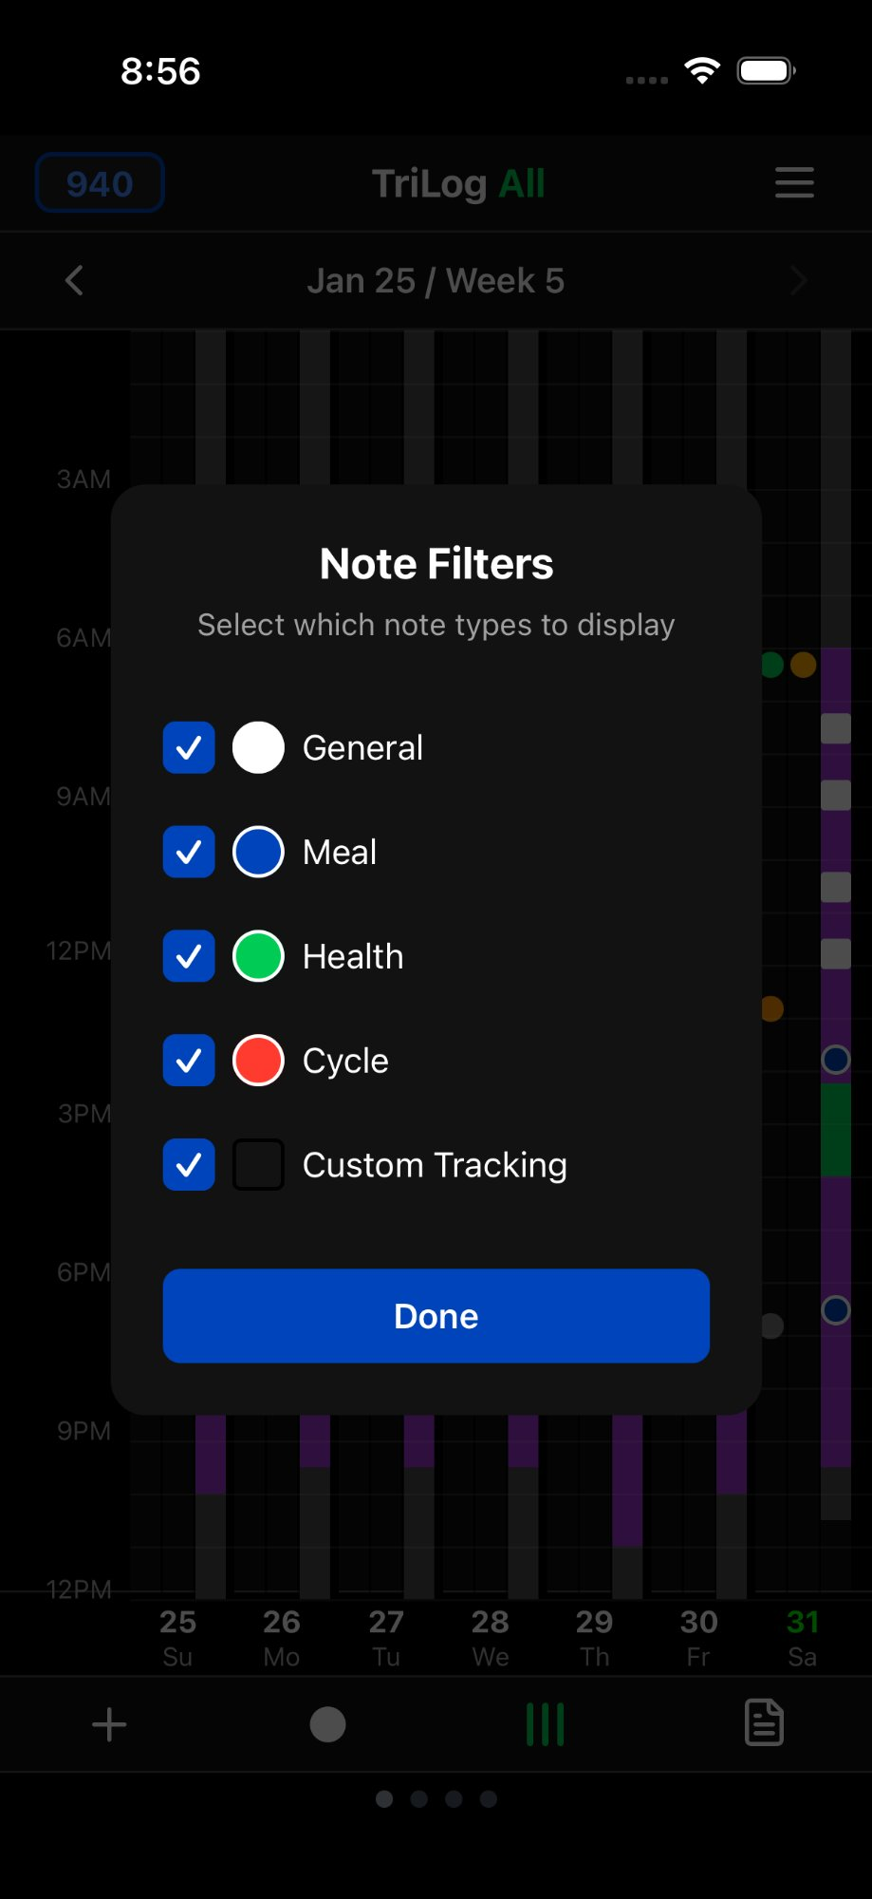
Add Context with Notes
Notes tell you why — not just how you felt, but what caused it
General
Meal Notes
Quick context: "bad sleep", "great workout"
Prefix with 'm': m lunch 450 — tracks calories
Health Notes
Cycle Notes
Prefix with 'h': h headache, h took ibuprofen
Prefix with 'cy': cy started, cy day 14
Also includes: shorthand expansions, search, and filterable note types
Grid with notes
Note filters

Slide 7
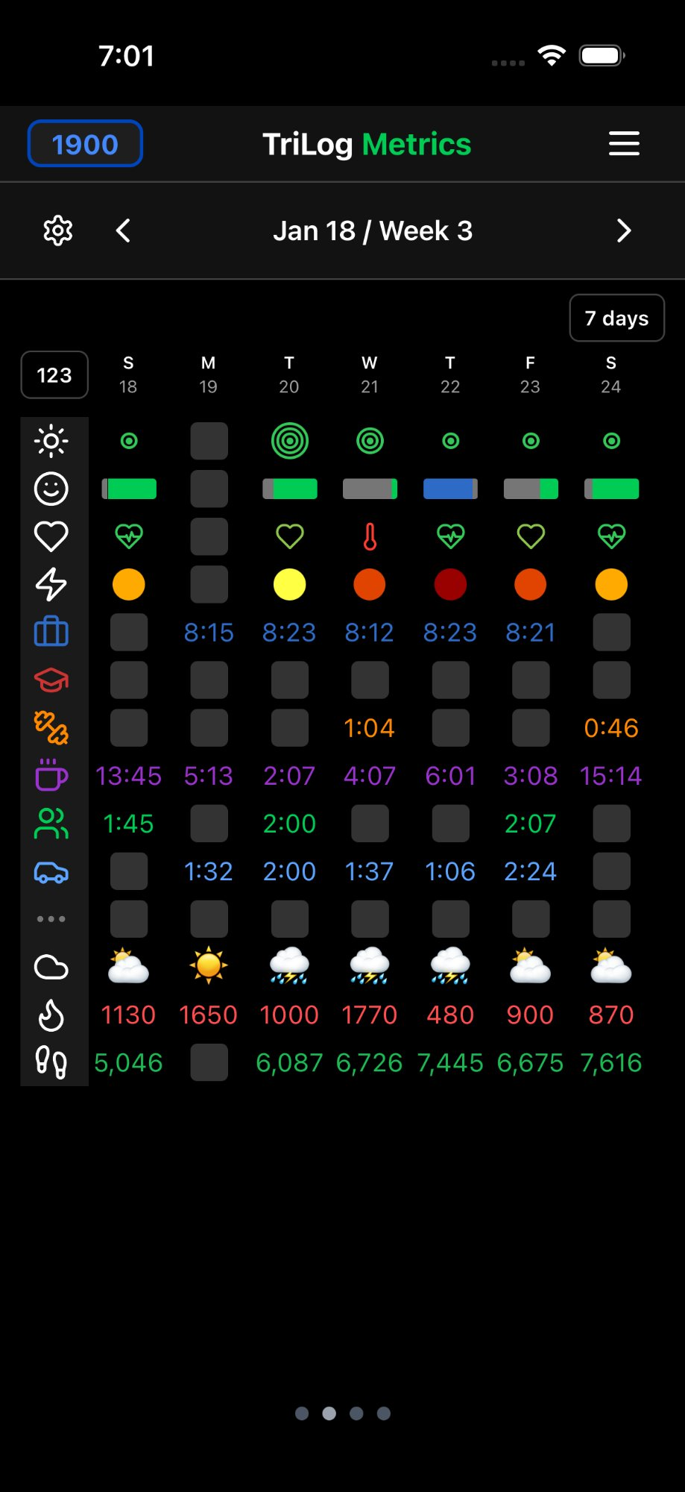
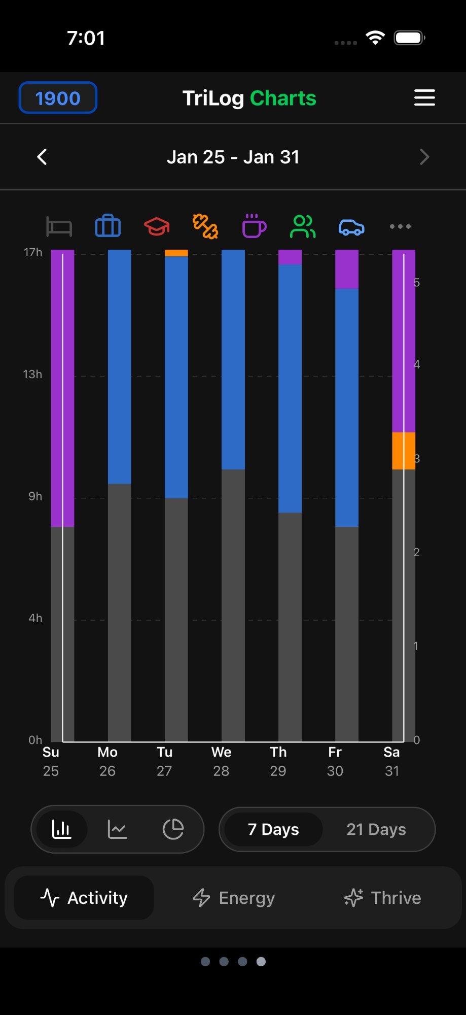
Metrics & Charts
Multiple views reveal different patterns in your data
Metrics Grid
Daily rows for mood, energy, sleep, steps, calories, and custom trackers.
Charts View
Bar and pie charts show activity distribution over 7 or 21 days.
Extended Views
14-day scrollable metrics and year-long habit views for deep pattern analysis.
7-Day Metrics Grid
Activity Bar Chart

Slide 8
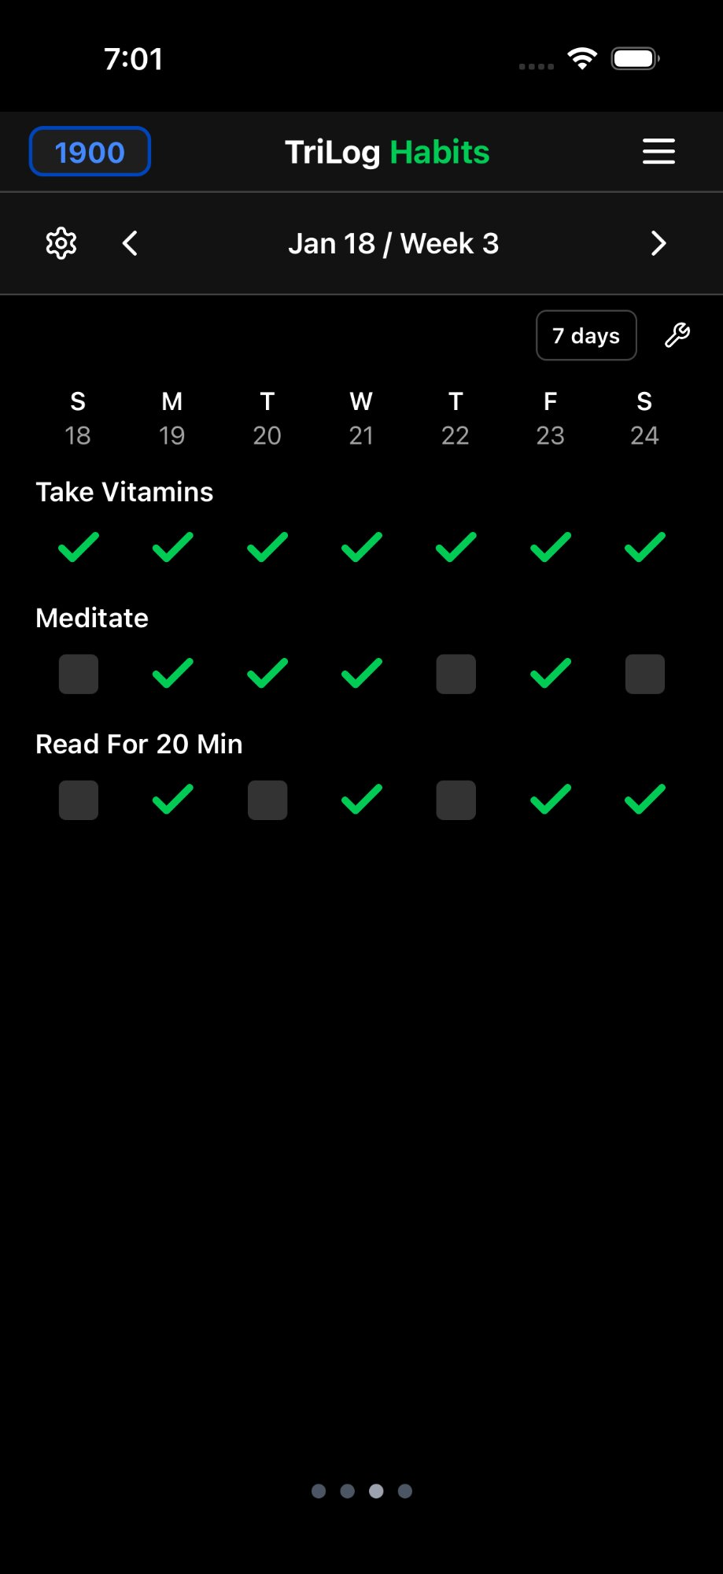
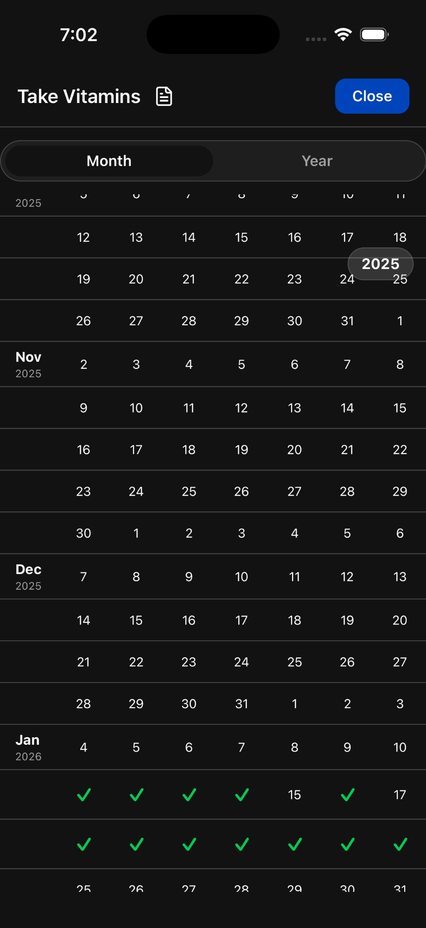
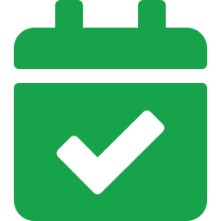
Build Better Habits
Daily recurring tasks tracked with visual consistency grids
How It Works
Create daily habits like meditation, vitamins, reading
Check off completions in Day End or the Habits grid
See 21-day consistency at a glance — solid rows = strong habits
Year-long calendar view shows long-term patterns
Weekday vs. weekend differences become obvious
Start with 1–3 habits, add more as they stick
21-Day Habit Grid
Year View

Slide 9
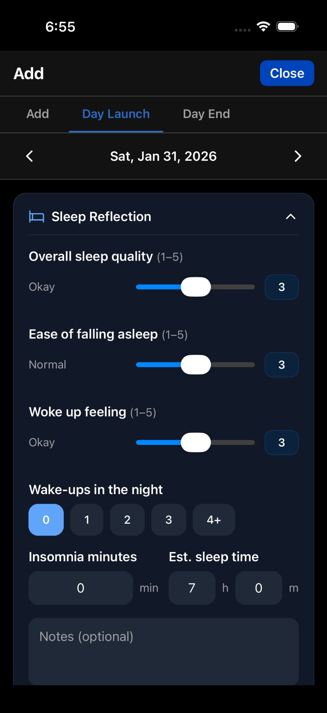
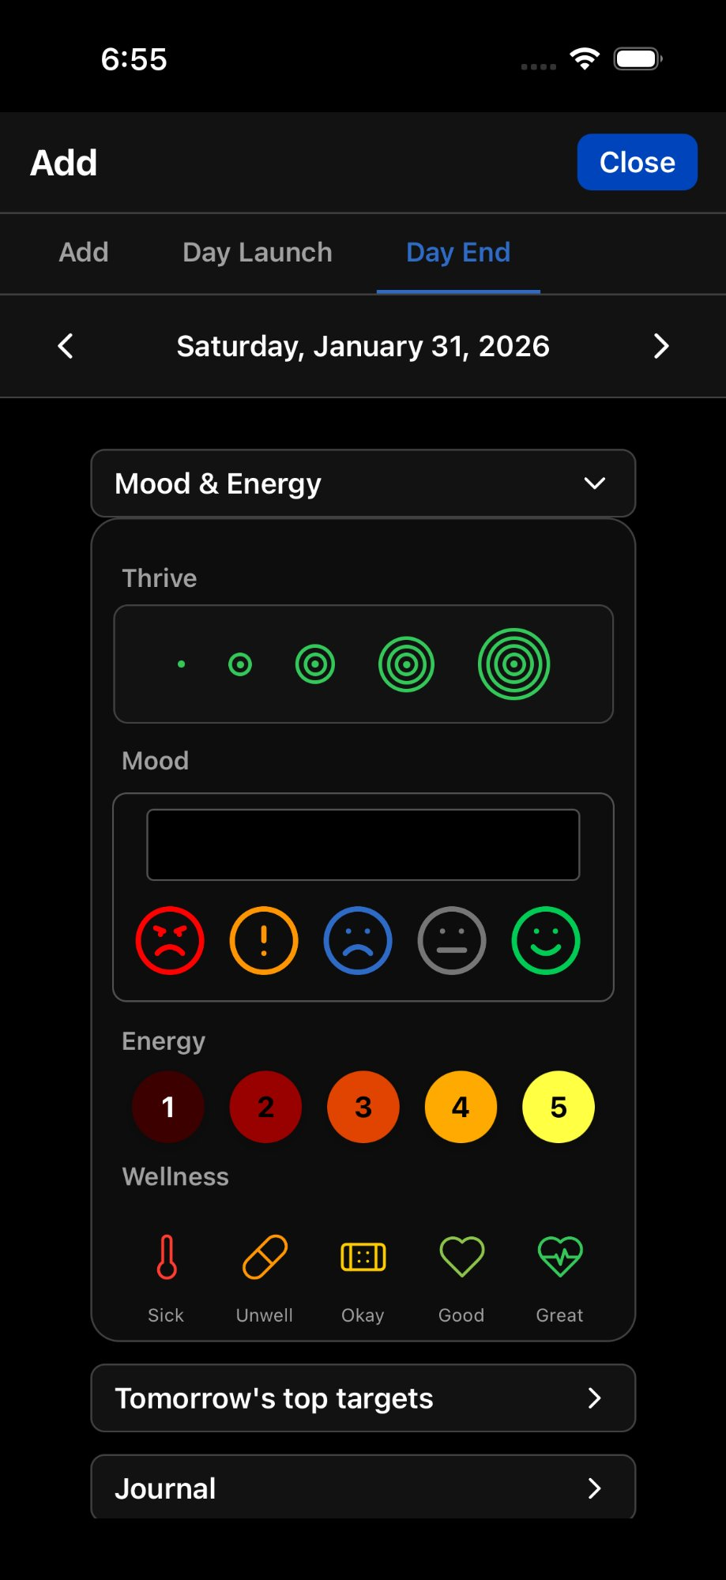
Day Launch & Day End
Optional structured routines for morning reflection and evening planning
☀️ Day Launch
🌙 Day End
Sleep Quality & Onset (0–5)
Waking feeling & wake-ups
Sleep duration & insomnia
Yesterday's goals review
Morning routine checklist (Pro)
Tomorrow's top 3 targets
Journal space for reflection
Habit completion checkboxes
Wellness check ratings
Resting heart rate (Pro, iOS)

Slide 10
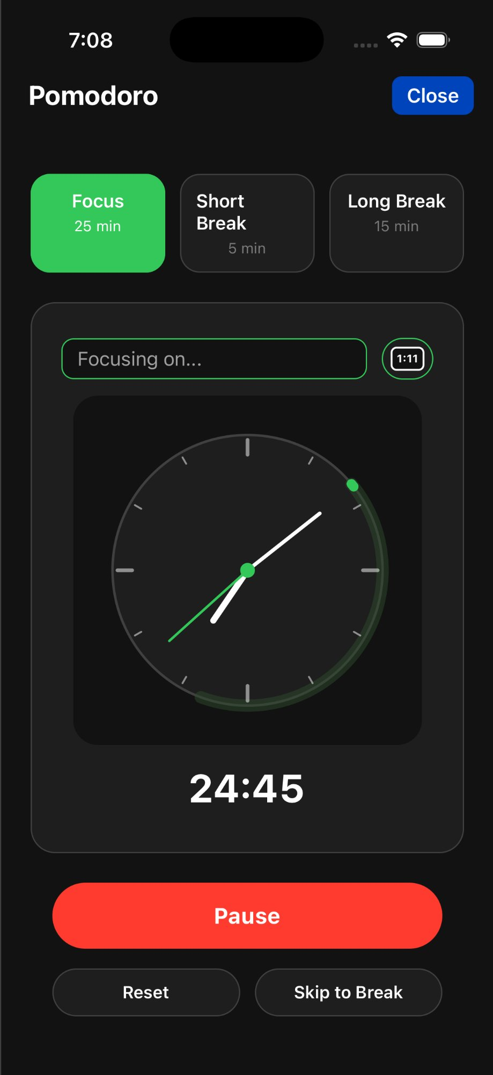
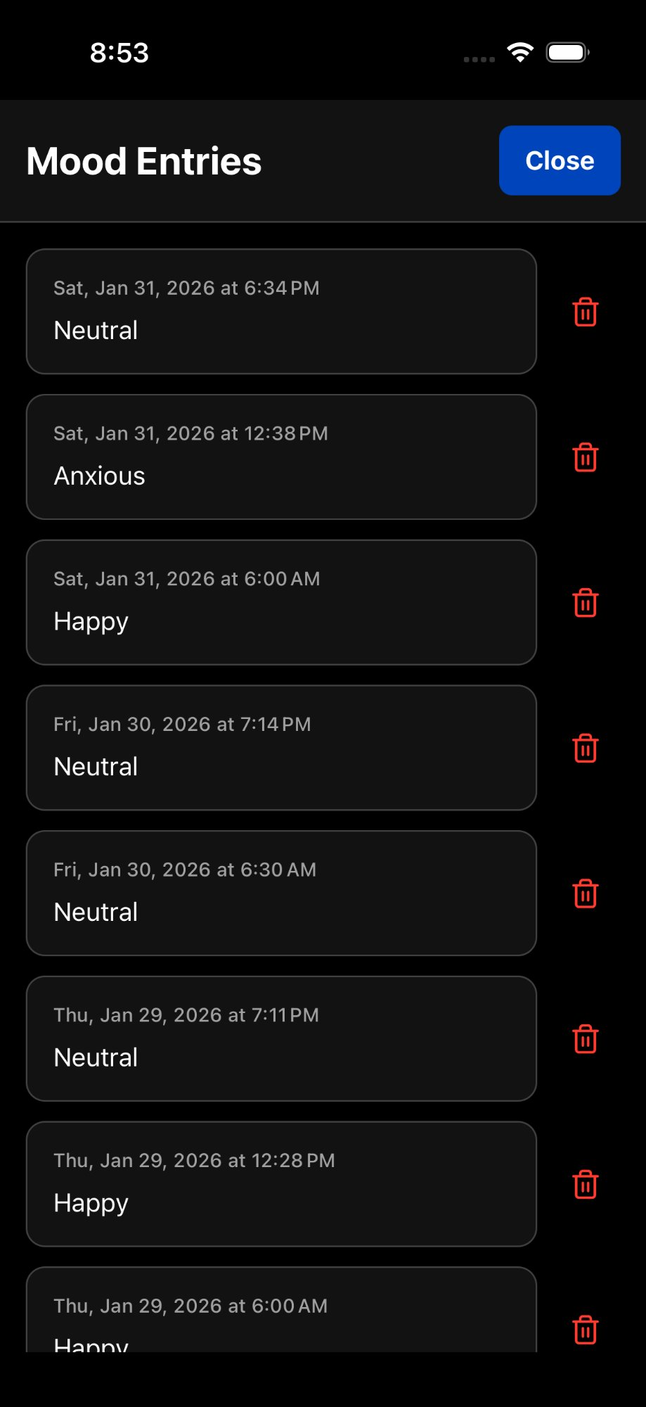
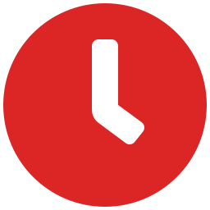

Pro Features
The free version is complete. Pro adds power features for dedicated trackers.
Pomodoro Timer
25-min focus sessions with short/long breaks. Tracks sessions and integrates with your timeline.
Custom Trackers
Track anything: water intake, medication, pain levels, coffee. Types: text, count, sum, traffic light.
Quick Track
Rapid one-tap logging without opening the full entry modal. Perfect with Polling.
Morning Routine
Customizable checklist in Day Launch. Markdown-based, resets daily.
Pomodoro Timer
Entry History

Slide 11
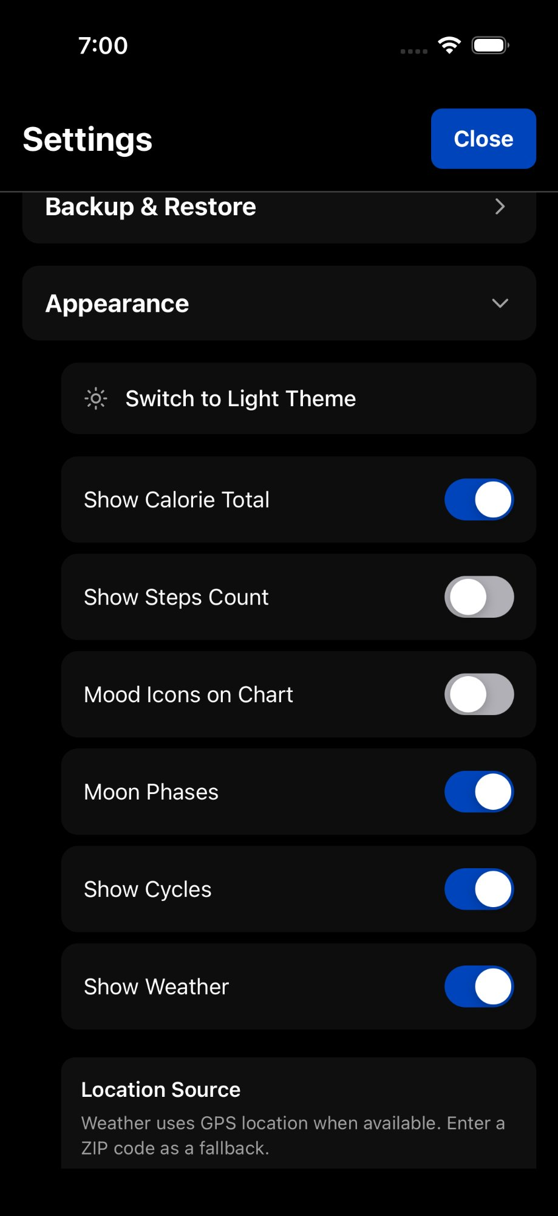
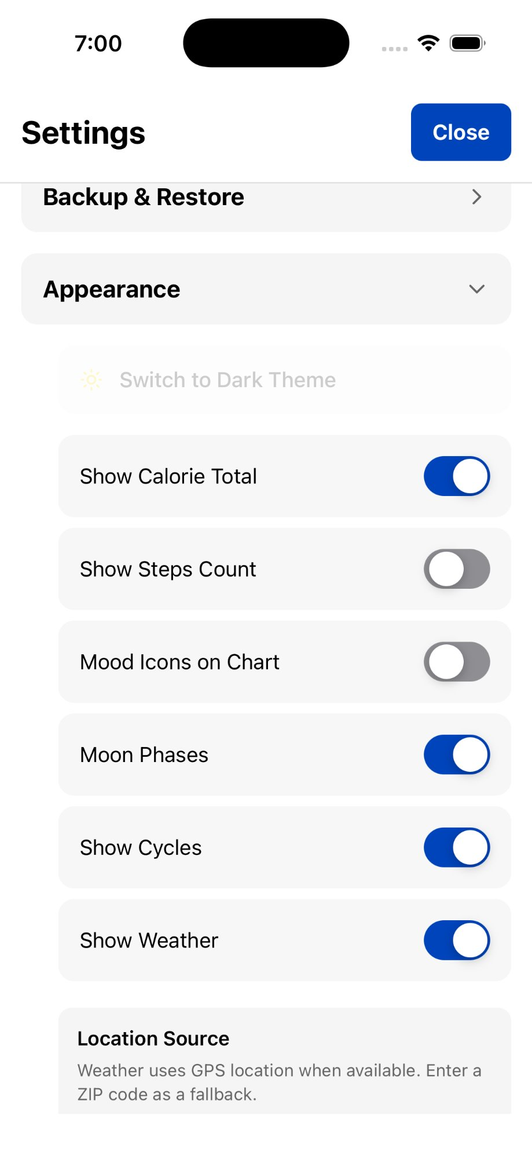
Your App, Your Way
Extensive settings let you show exactly what matters to you
Display Toggles
Calories, Steps, Moon Phases, Weather, Cycles, Mood Icons, View Dots
Theme
Light, Dark, or follow System preference
Backup & Restore
iCloud auto-sync, database export, Google Sheets export
View Management
Show/hide Trackers and Habits grids, customize Metrics rows
Privacy First
All data stored locally on device. Your data is yours alone.
Appearance Settings
Light Theme Settings

Slide 12
The Longer You Track, The More You See
First Week
First Month
Several Months
A Year+
Learning the app. Finding your logging rhythm.
Patterns emerge: energy dips, mood correlations, sleep effects.
Weekly rhythms, monthly cycles, life change impacts visible.
Seasonal patterns. A profound record of your life.
The goal isn't to optimize your life. It's to notice it.
Tracking without reviewing is like writing a journal you never read. TriLog makes the review effortless.
Download TriLog
Free on the App Store • Pro subscription for power features

